Slide 1
Transaction Monitoring Process
A Statistical APPROACH

Slide 2
Introduction
The major concern today
Too many alerts need to be investigated.
Alerting rules generate many false alerts because of heterogenous nature of profiles of transactions and hence low relevance of rules.
Goal of transaction monitoring = Reduce number of falsely generated alerts and thus reduce investigator’s workload. Also increase investigating efficiency through narrowed focus.
Advantage of statistical approach = minimum bias towards customer profiles, mathematically sound and rational.

Slide 3
How To Do It? A Two Stage Process
Optimization Upstream
Stage 2
Optimization Downstream
Stage 1
Investigation
Transactions
Alerts
Cases
SAR

Slide 4
How To Do It? A Two Stage Process
Optimization Upstream
Stage 2
Optimization Downstream
Stage 1
Investigation
Transactions
Alerts
Cases
SAR
Model building:
Here we are!

Slide 5
How To Do It? A Two Stage Process
Less alerts with tuned scenarios!
Optimization Upstream
Stage 2
Optimization Downstream
Stage 1
Investigation
Transactions
Alerts
Cases
SAR
Model building:
Autoclosed alerts
Tune scenario rules!

Slide 6

Optimisation Overview
where π = probability of SAR
Downstream Optimisation – Stage 1
Goal -
Create predictive model for each customer profile to predict SAR.
Explain importance of the variables!
Find optimal cut off values for predictors to auto-close any non-risky alerts
Upstream Optimisation – Stage 2
Goal –
Tune the rules to reduce the number of alerts generated
Do this for each customer profile.

Slide 7
Downstream Optimisation: Stage one - Steps
Initial data cleaning
Top down segmentation
Feature selection, replacing missing values
Standardization and exploratory analysis
Bottom up clustering
Model building
Model evaluation
Explaining Model And Autoclosing Alerts
Data Cleaning And Clustering
Model Building
Model Evaluation

Slide 8
Downstream Optimisation - Steps
Initial data cleansing = variable extraction and variable deletion, removing duplicates, removing observations where SAR variable not available
Top down clustering = grouping of your data based on domain knowledge
why? Because money launderers in different groups will conduct fraud in different ways
So.. We need a model for each discovered group if we want the system to be effective
BUT.. At the same time, we want to keep the number of models as small as possible.
HOW? Put groups together with similar characteristics in terms of predictors.
Initial data cleaning
Top down segmentation
Feature selection, replacing missing values
Standardization and exploratory analysis
Bottom up clustering
Model building
Model evaluation
Explaining Model And Autoclosing Alerts

Slide 9
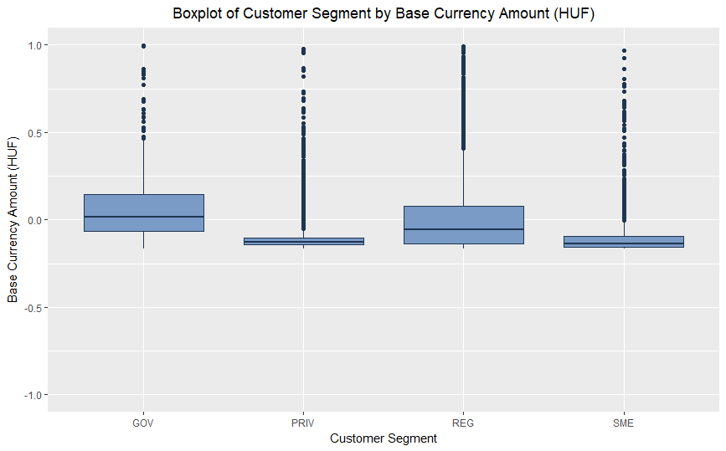
Downstream Optimisation - Steps
We will try all below and compare -
REG and GOV vs SME and PRIV (data)
REG GOV and SME vs PRIV (hypothesised)
REG vs GOV vs SME vs PRIV (hypothesised)
We first explored cluster solution 1!

Slide 10
Downstream Optimisation - Steps
Before we went any further we had one large issue – huge amount of missing data!
Issues
Some models can’t deal
Clustering can’t deal
Not ideal as can bias results – important to deal with as well as possible
How to deal?
Replace – replaced with mean (continuous) or mode (categorical)
Delete – simple option but lots of data loss
Keep – if value missing for a reason then it can be meaningful eg, in TXN_TYPE, only applies to single transactions hence any alerts based on multiple transactions will have missing value
Initial data cleaning
Top down segmentation
Feature selection, replacing missing values
Standardization and exploratory analysis
Bottom up clustering
Model building
Model evaluation
Explaining Model And Autoclosing Alerts

Slide 11
Downstream Optimisation - Steps
Feature Selection –
Delete variables with > 15% missingness, if larger than this its not reliable to replace!
Exception of the 6 variables where missingness is normal eg. TXN_TYPE, mentioned before
30 variables remain after starting with 134– success!
Replacing Missing Values –
For variables where missingness is normal – let the missing values be a category in these categorical variables
For the remaining variables with missingness – first looked for patterns in other related variables, if none we replaced with mean (continuous) or mode (categorical) – simple but can gives decent results
More complicated approaches exist but often not worth the hastle in terms of results
Initial data cleaning
Top down segmentation
Feature selection, replacing missing values
Standardization and exploratory analysis
Bottom up clustering
Model building
Model evaluation
Explaining Model And Autoclosing Alerts

Slide 12
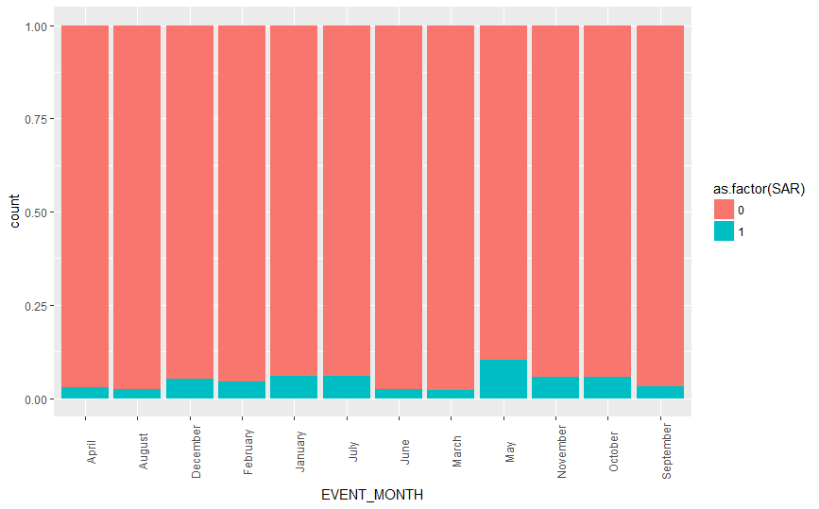


Step 4 - Standardization and exploratory analysis
Exploratory Analysis –
Why do it? - To get an idea of how good each variable is
The more discrepancy between the levels the better the variable
Information gain value – used to rank variable importance
Standardisation –
For categoricals –
Why do it? –
Categoricals with many levels means lots of parameters to estimate in logistic model
Decision trees have trouble with categoricals with many levels
Cluster analysis cant use categorical variables to group observations
Solution ? - Ridit scoring, converts categorical to a continuous range [-1,1]
Highly negative = more proportion of SAR, Highly positive = less proportion of SAR
For continuous –
Why do it? –
Variables with huge range of values compared to others cause issues in regression based models (logistic) and clustering
Solution ? – transform variables to have N(0,1) distribution – works well for regression based models and clustering, not for decision tree models!
Standardisation -

Slide 13
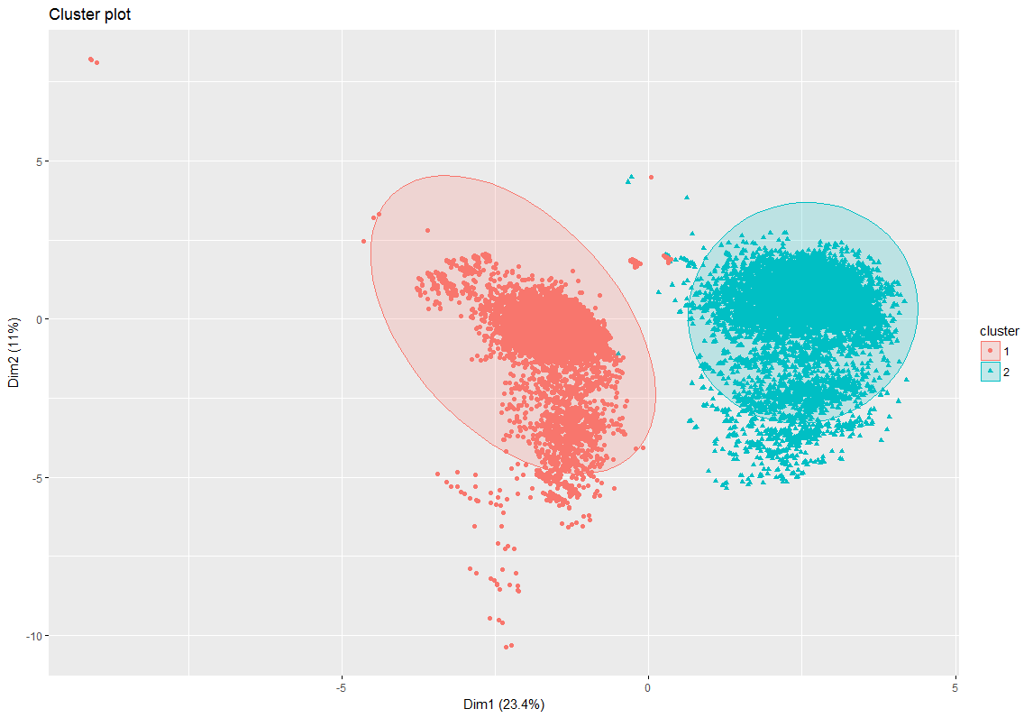
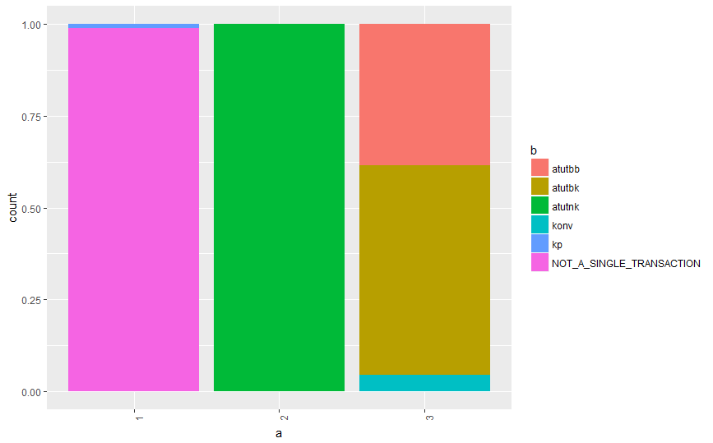
Step 5 – Bottom Up Clustering
What is it ? –
Purely statistical way of grouping alerts
Similar within groups, different between groups
Why do it ? –
Idea is that different groups have different important variables for predicting SAR eg, BUSINESS TYPE important for companies but not so much for individuals
Create customer profiles based on a few important variables
What did we do? -
Found optimal number of clusters to choose – gap statistic!
Tried 3 different clustering techniques suited to big data sets and compared based on:
Ease of customer profiling
Measures of homogeneity and heterogeneity
Split data once more into different clusters and we can prepare to make a model for each!
NOTE: We should go as far as the end of this step and then go back to step 2 and repeat for cluster solution 2, and then the same for cluster solution 3. Then choose which top down cluster is best based on homoegeneity of the bottom up clusters and also the ease of customer profiling

Slide 14
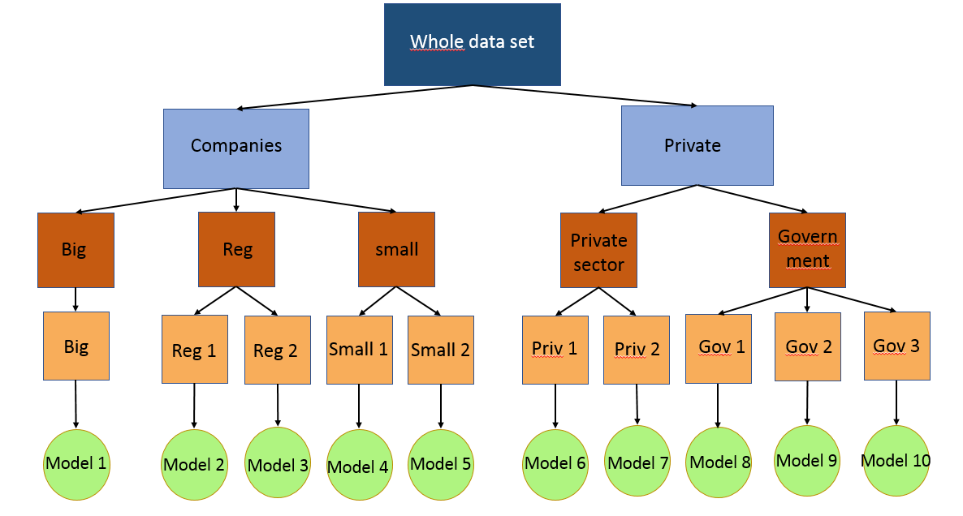
Example relating Top down and Bottom up clustering
Top down clustering
Bottom up clustering
Note that you want to keep the number of clusters as small as possible. More clusters mean more models to be build!

Slide 15
Step 6 – Model Building
Before starting set aside a test data set – very important for evaluation!!!
Once we have decided our best top down cluster solution and number of bottom up clusters we will have approximately 10 splits in the data. We must make a model for each.
Goal of our model –
predict the probability that an alert is a SAR or not a SAR
Use risk scoring techniques to ensure we can explain the roles of different variables in the model
Determine optimal cutoff risk score to autoclose some alerts.
Where to start? –
On each split we tried lots of models (Logistic regression, Decision trees)
Give all variables to model, select the best ones and compare using some statistical measures, we put forward a couple of potentially good models
Evaluate!
…But first we must deal with the class imbalance issue!

Slide 16
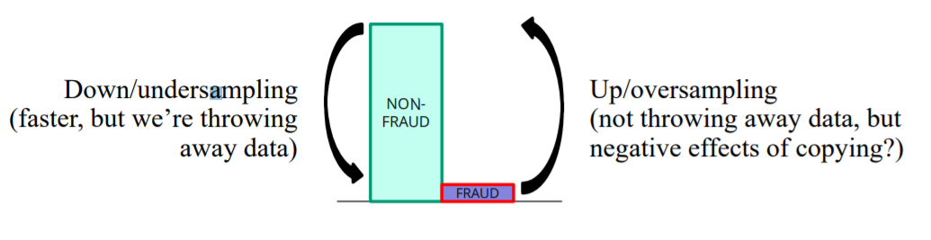
Step 6 – Model Building (Class Imbalance Issue)
What is it? –
If we have such unbalanced SAR variable (lots of No SAR’s and not so many SAR’s) then we can have issue trying to predict SAR
Why is it important to deal correctly?
If we have a model that always predicts No SAR then 99% of the time you’re correct – Model looks like its doing well but it will never predict a SAR – issue!
Most algorithms behave badly when the data sets are highly imbalanced
What will we do?
Downsampling –throw away majority class observations
Upsampling – make up observations for minority class
SMOTE – Mixture of both
Try all and compare performance

Slide 17
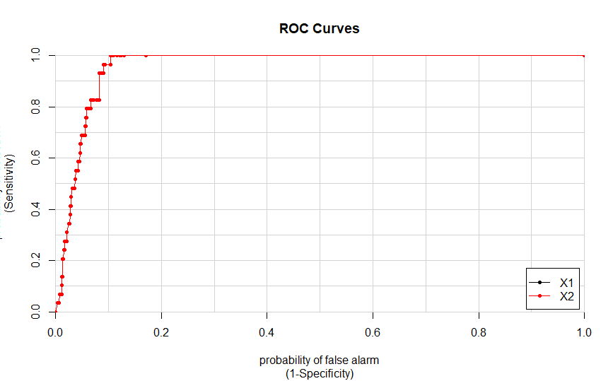
Step 7 - Evaluation
But how do we choose which is best model ? -
Method of evaluating = 10 fold cross validation
Gives a good estimate of how model will perform on a different dataset
Evaluation measure = ROC curve and Area Under Curve (AUC)
Goes from 0 to 1
Takes into account False Positive (FP) rate of predictions and True Positive (TP) rate
Highly suitable for our problem!
Compare AUC of different models and pick best
Evaluation on test data set -
Once we have selected our best model in each split
Calculate AUC for each
Gives real idea of performance of model on different data set.
Random Forest has AUC=0.959 for one of our clusters!
Next to explain it!

Slide 18
Step 8 – Explaining Model And Autoclosing Alerts
Model Explainability-
Very important – explain why we auto closed alert
Black box – Random Forest
White box – Logistic regression, Decision Tree
Auto closing –
For Logistic:
Determine optimal cut off probability to split up SAR and no SAR
Other:
No need to determine cut off probability
End product = Less False Positive alerts to investigate!

Slide 19
Downstream Optimisation – Summary
Data Cleaning and Clustering –
Initial data cleaning
Top down clustering
Feature selection, replacing missing values, standardization and exploratory analysis
Bottom up clustering and customer profiling
Model Building
Set aside test data set
Dealing with class imbalance issue
Trying various understandable models
Model Evaluation
Method of evaluating = 10-Fold-Cross-validation
Evaluation measure = ROC curve AUC (on dataset test also)
Explain model and determine best cut off value for autoclosing
Less alerts to investigate = less work to do

Slide 20
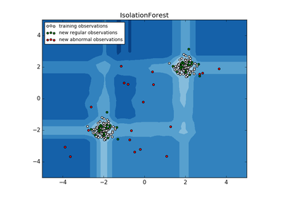
Alternative Method – Anomaly Scoring using Isolation Forest
Exploring different approaches is the goal of our work here!
What is it? – Using the principle that money launderering transactions are rare we will assign a score to each alert based on how rare its behavior is with respect to the customer profile.
Anomaly score is based on isolation trees and finding the path length of each observation w.r.t an iTree.
General structure
Data cleaning and customer profiling (steps 1-5 as before)
Score each transaction on rareness of behavior within customer profile
Determine cut off value for separating SAR’s from No SAR’s

Slide 21
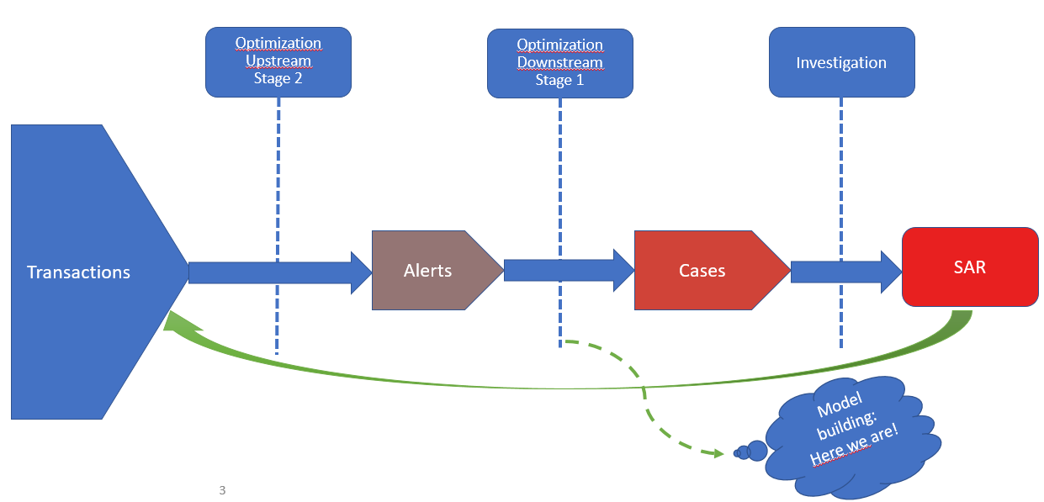
Upstream Optimisation: Stage two - Overview
Review of Process

Slide 22
Upstream Optimisation: Stage two
Less alerts with tuned scenarios!
Optimization Upstream
Stage 2
Optimization Downstream
Stage 1
Investigation
Transactions
Alerts
Cases
SAR
Model building:
Autoclosed alerts
Tune scenario rules!

Slide 23
Upstream Optimisation – Overview
General overview:
Take alerts generated from a scenario and extract current rules and current thresholds.
Segregate these alerts based on customer profile and obtain thresholds for each variable in the scenario.
Tune the thresholds for this scenario by comparing current rules and thresholds with those from model.
Repeat for all scenarios.

Slide 24
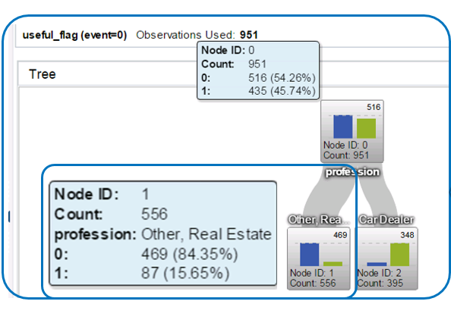
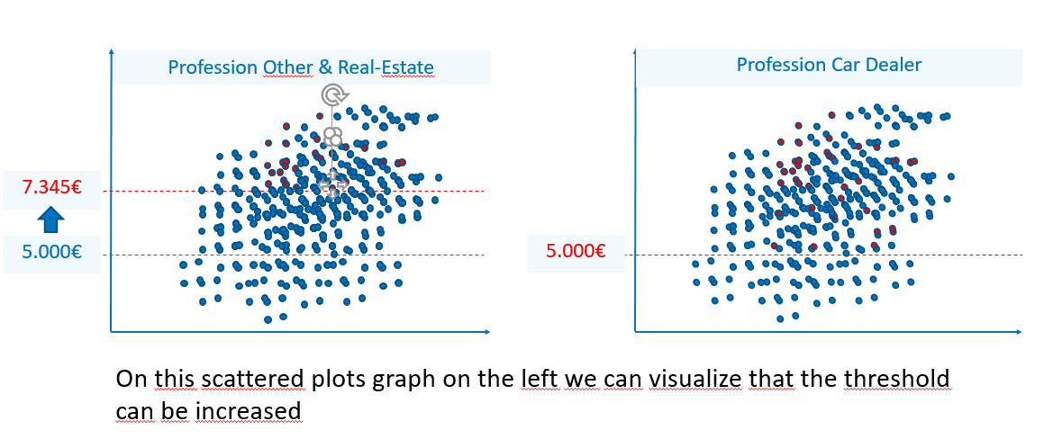
Upstream Optimisation – Process of rule tuning
Start with a scenario and a customer profile.
Find most pure variable in dataset using decision tree
Plot this variable against each variable mentioned in the scenario
Do ABL and BTL testing to see can we raise the line
Repeat for each customer profile
Repeat for each scenario

Slide 25
Optimisation Process
Less alerts with tuned scenarios!
Optimization Upstream
Stage 2
Optimization Downstream
Stage 1
Investigation
Transactions
Alerts
Cases
SAR
Model building:
Autoclosed alerts
Tune scenario rules!

Slide 26
Optimisation Summary
Downstream Optimisation – Stage 1
Data cleaning and clustering
Model building
Model Evaluation
Upstream Optimisation – Stage 2
Extract current rules and thresholds for alerts in a scenario.
Segregate these alerts based on customer profile and obtain thresholds for each variable in the scenario.
Tune the thresholds by comparing current rules and thresholds with those obtained.
Repeat for all scenarios.

Slide 27
Prospective methods which can be tried to optimize false alerts ..

Slide 28
Sub group discovery Algorithm
For obtaining scenarios (rules in paper jargon) based on rules (conditions in paper jargon) which are multivariate decision splits using quality (TP/FP+g) (by which rules are descended) and support (purity of TP w.r.t sample size) as thresholds.
Basically creates new set of scenarios.
Runs systematically through all variable values, variables and combinations of variables and their combinations.
Have characteristic similar to ROC called quality which has generalization parameter ‘g’ which can be used to specify allowable false positive rate.

Slide 29
Active Learning through Sequential Design
The method uses a combination of stochastic approximation and D-optimal designs to judiciously select the accounts for investigation.

Slide 30
Reference
http://www.cs.cmu.edu/afs/cs/project/jair/pub/volume17/gamberger02a-html/node4.html Sub group discovery algorithm
Active Learning Through Sequential Design, With Applications to Detection of Money Laundering Xinwei Deng, V. Roshan Joseph, Agus Sudjianto and C. F. Jeff Wu Journal of the American Statistical Association Vol. 104, No. 487 (September 2009), pp. 969-981

